Slide 1
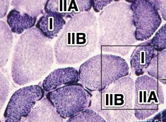
PHOL0001
Skeletal Muscle
Dr. Pam Houston

Slide 2
Skeletal Muscle
This lecture will cover:
The principal morphological characteristics of the three main types of muscle
The detailed structure of skeletal muscle
Excitation-contraction coupling in skeletal muscle
The mechanism of contraction in skeletal muscle
The mechanical properties of skeletal muscle

Slide 3
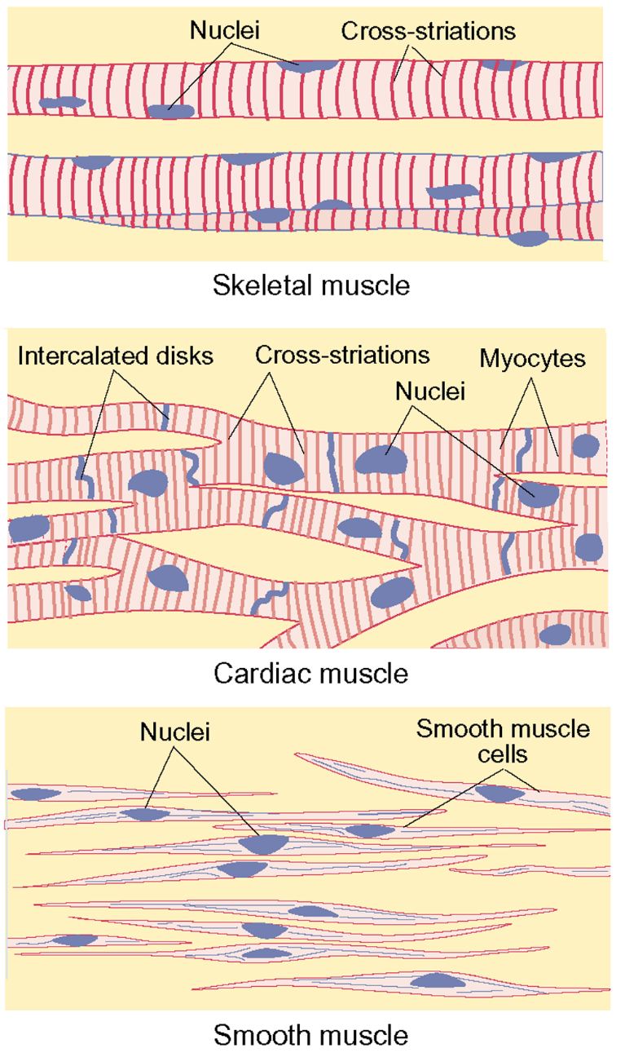
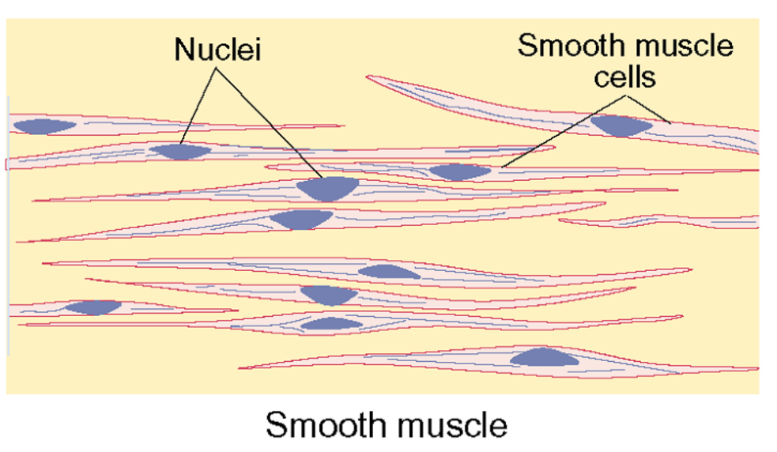
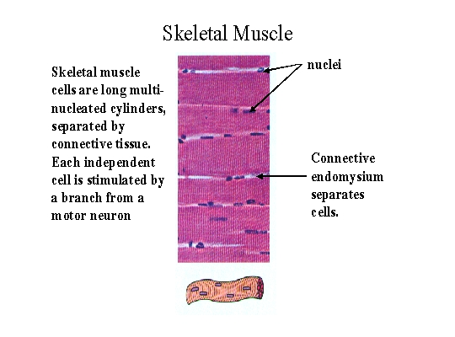
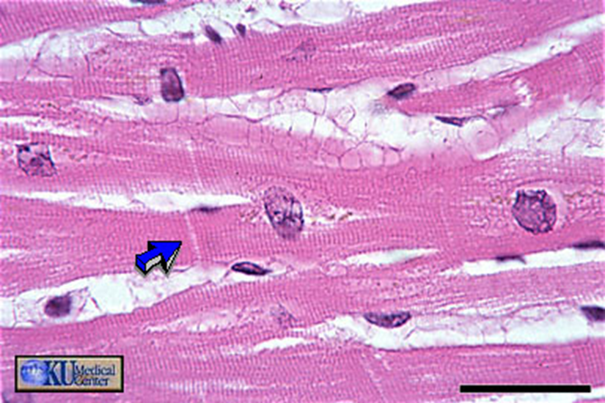
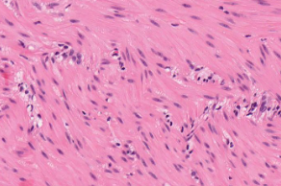
Muscle Types
Skeletal | Cardiac | Smooth
Begins and ends in a tendon | Heart | Viscera, hollow organs/blood vessels
Prominent striation, multi- nucleated | Less prominent striation, | Not striated, 1 nucleus
voluntary | involuntary | involuntary
long, cylindrical multinucleated | cylindrical branched mono/binucleated | spindle-shaped mononucleated
Notes:
Cardiac muscle cells are 10-20 µm in diameter, 50-100 µm in length, connected end to end at intercalated discs for mechanical and electrical continuity, at desmosomes (fascia adherens) and gap junctions, respectively; myocardium, functional syncytium.
Smooth muscle cells are about 2-10 µm wide and 100-400 µm long. They are joined together both mechanically (at intermediate junctions) and electrically (at gap junctions), to form functional units in bundles or sheets.

Slide 4
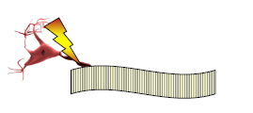
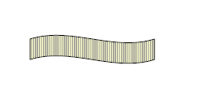
Activation of Muscle
Skeletal muscles are activated by action potentials in the motor nerves
  neurogenic contractions
Cardiac and most smooth muscle have an intrinsic rhythm that is modulated by action potentials in autonomic nerves
  myogenic contractions

Slide 5
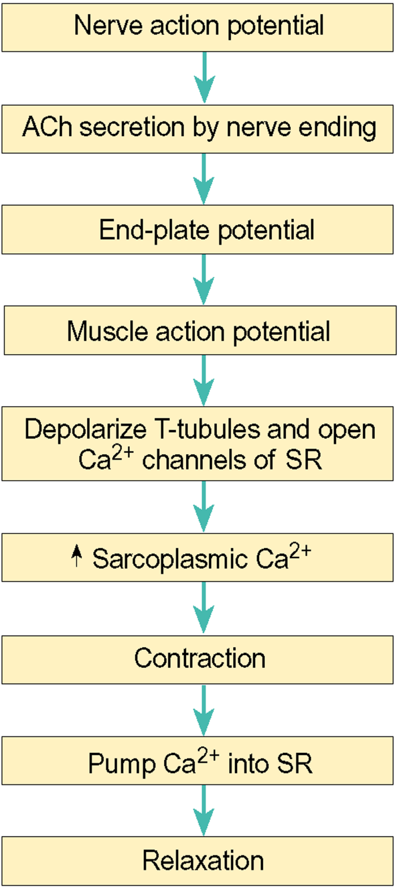
How a skeletal muscle contraction is initiated:
Excitation-Contraction
resting cytosolic concentration ~100 nmol to a peak of 0.1 to 1 µmol during a normal contraction
Notes:
Excitation–Activation–Contraction Coupling
The processes of excitation–activation–contraction coupling link electrical
events of an action potential to the mechanical events of tension development
and subsequent muscle relaxation. Ca++ plays a crucial role in these
processes, rising from a resting cytosolic concentration near 100 nmol to a
peak of 0.1 to 1 µmol during a normal contraction. The source of this Ca++
is the SR.

Slide 6
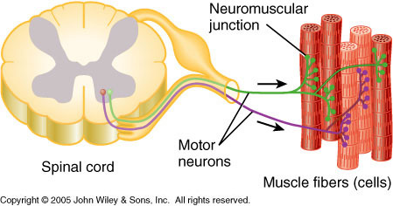
Innervation
Skeletal muscles are supplied by nerve fibres that are myelinated and have their origin in the CNS.
Such nerves are called motor nerves.
When a motor nerve fibre enters a muscle, it branches so that one motor axon makes synaptic contact with a number of muscle fibres.
The motor neuron, its axon and all the muscle fibres supplied by the axon and its branches form a motor unit.

Slide 7
Muscle Fibre Anatomy
Sarcolemma is the muscle cell plasma membrane
Surrounds the sarcoplasm (cytoplasm of fibre)
  Contains many of the same organelles seen in other cells
  An abundance of the oxygen-binding protein myoglobin
  Punctuated by openings called the transverse tubules (T-tubules). Narrow tubes that extend into the sarcoplasm at right angles to the surface, filled with extracellular fluid.
Myofibrils are cylindrical structures within muscle fiber
Are bundles of protein filaments (myofilaments)
Two types of myofilaments:
  Actin filaments (thin filaments)
  Myosin filaments (thick filaments)
At each end of a fibre, myofibrils are anchored to the inner surface of the sarcolemma, therefore when myofibrils shorten, muscle shortens (i.e. contracts).

Slide 8
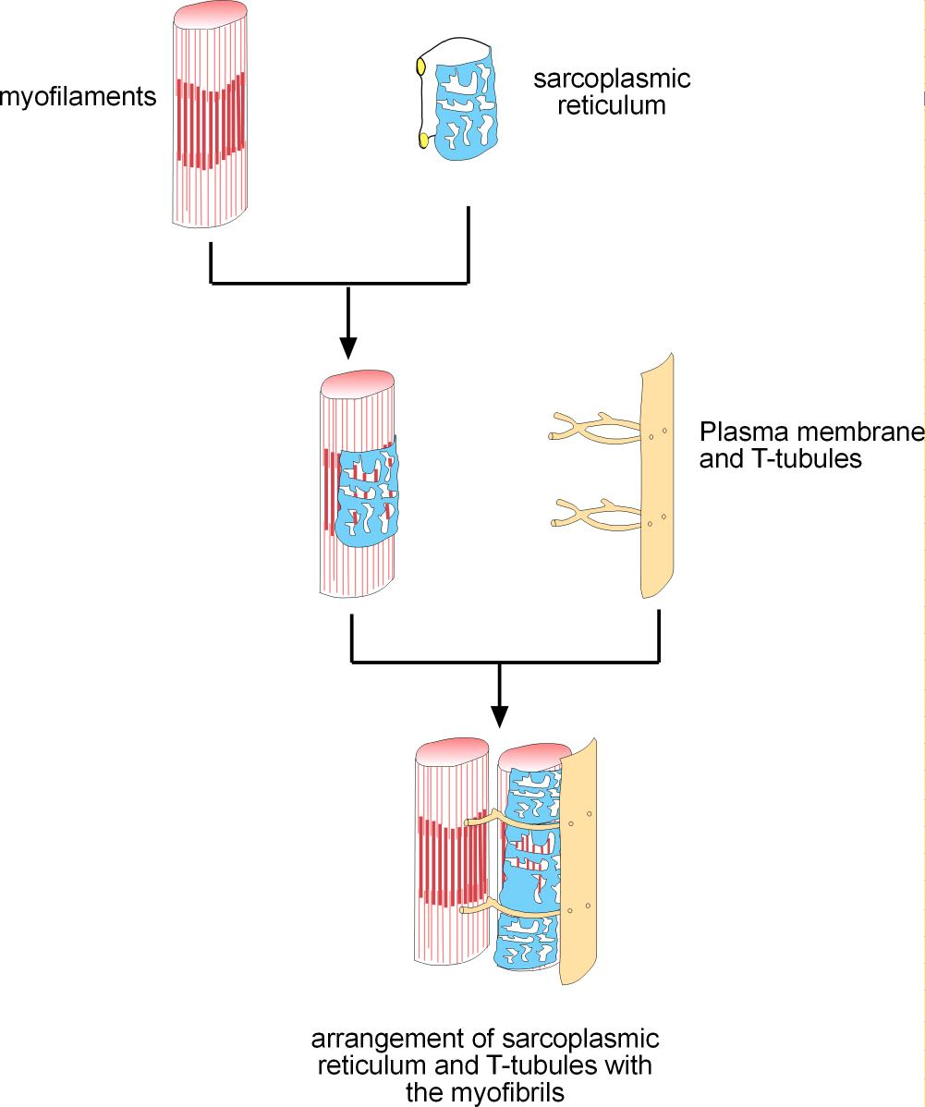
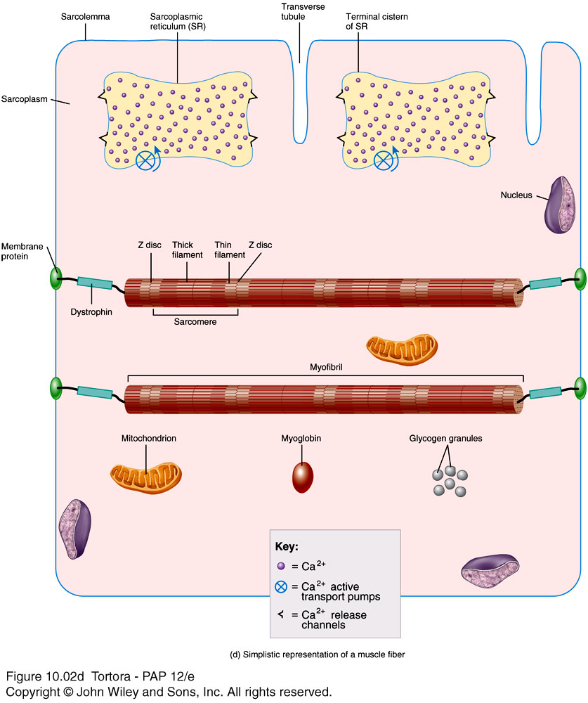
Muscle Membranes
Notes:
Sarcoplasmic Reticulum
This membrane-lined structure has evolved as a region specialized for
uptake, storage, and triggered release of Ca++. Its longitudinal elements are
aligned with the long axis of muscle fibers and are rich in proteins that
pump or store Ca++. Near the T-tubules, the slender longitudinal channels
broaden to form the cisternae that surround the T-tubules. These regions
are rich in proteins that act as Ca++ release channels.
Sarcomere
The sarcomere is the contractile unit. It is bounded by two neighboring Zlines
(see Figure 2–2) and contains three types of proteins that are specialized,
respectively, for structure, contraction, and regulation of contraction.

Slide 9
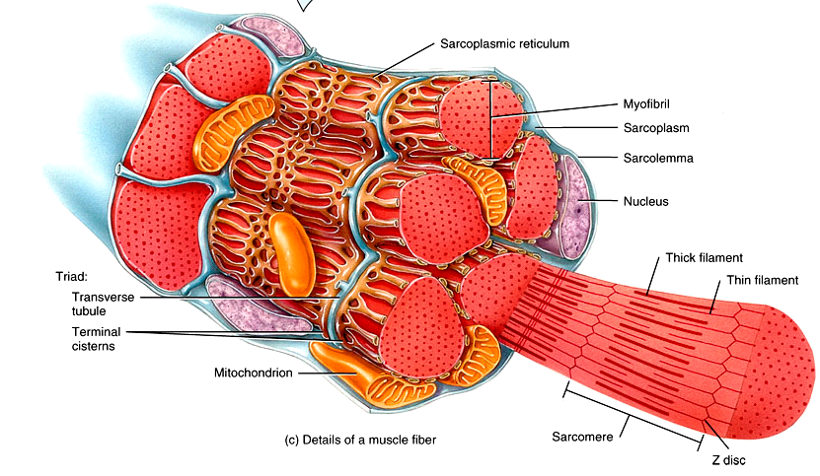
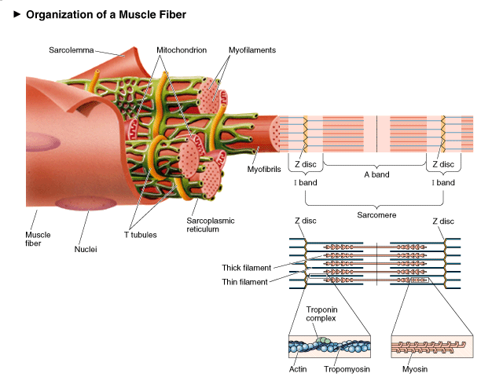
Muscle Fibre
Contractile proteins
Actin- thin myofilament
Myosin- thick filament
Regulatory proteins
Tropomyosin
Troponin
Attachment proteins
Titin, nebulin, alpha actinin, dystrophin
Tortora “Principles of Anatomy & Physiology” 12th Ed
Notes:
It is classified, on the
basis of its microscopic appearance, as striated muscle or smooth muscle.
This difference arises from the different physical arrangements of the contractile
proteins.
STRIATED MUSCLE
Striated muscle is further divided into skeletal muscle and cardiac muscle.
• Skeletal muscle typically bridges two attachment points on the skeleton
and is in a relaxed state, unless there is a need for motion of one attachment
point relative to the other.
• Cardiac muscle is arranged so as to form a hollow bag, suspended from
a fibrous ring. It contracts and relaxes throughout life and at a rate
between 35 and 200 beats per minute.
Morphology of Striated Muscle
A muscle consists of several muscle columns.* Each column consists of several
muscle fibers (Figure 2–1), and each fiber consists of several myofibrils,
each 1 to 2 µm in diameter.Myofibrils clearly show repeating motifs of light
and dark bands, bounded at intervals of about 2 µm by narrow, dark bands
called the Z-lines.A typical cell incorporates several myofibrils, Z-lines, and
nuclei and is bounded by an external membrane, called the sarcolemma.

Slide 10
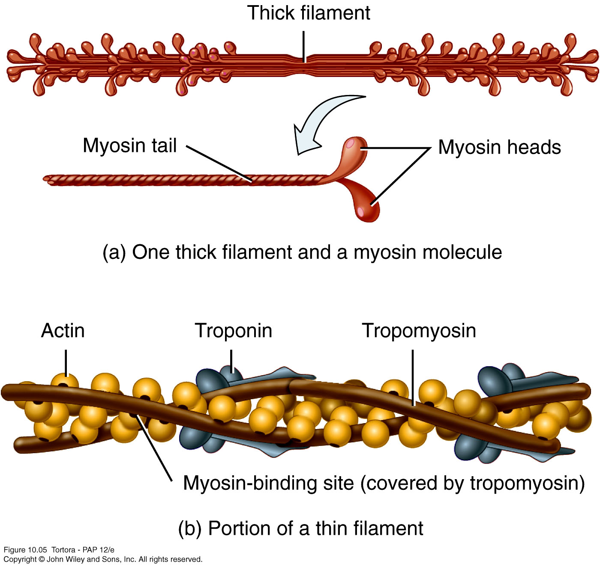
10_05
Filaments
Notes:
Thin Filament: composed of 3 major proteins
F (fibrous) actin
Tropomyosin
Troponin
Two strands of fibrous (F) actin form a double helix extending the length of the myofilament; attached at either end at sarcomere.
Composed of G actin monomers each of which has a myosin-binding site
Actin site can bind myosin during muscle contraction.
Tropomyosin: an elongated protein winds along the groove of the F actin double helix.
Troponin is composed of three subunits:
Tn-I : binds to actin
Tn-T :binds to tropomyosin,
Tn-C :binds to calcium ions.
Myosin
Many elongated myosin molecules shaped like golf clubs.
Single filament contains roughly 300 myosin molecules
Molecule consists of two heavy myosin molecules wound together to form a rod portion lying parallel to the myosin myofilament and two heads that extend laterally.
Myosin heads
Can bind to active sites on the actin molecules to form cross-bridges. (Actin binding site)
Attached to the rod portion by a hinge region that can bend and straighten during contraction.
Have ATPase activity: activity that breaks down adenosine triphosphate (ATP), releasing energy. Part of the energy is used to bend the hinge region of the myosin molecule during contraction

Slide 11
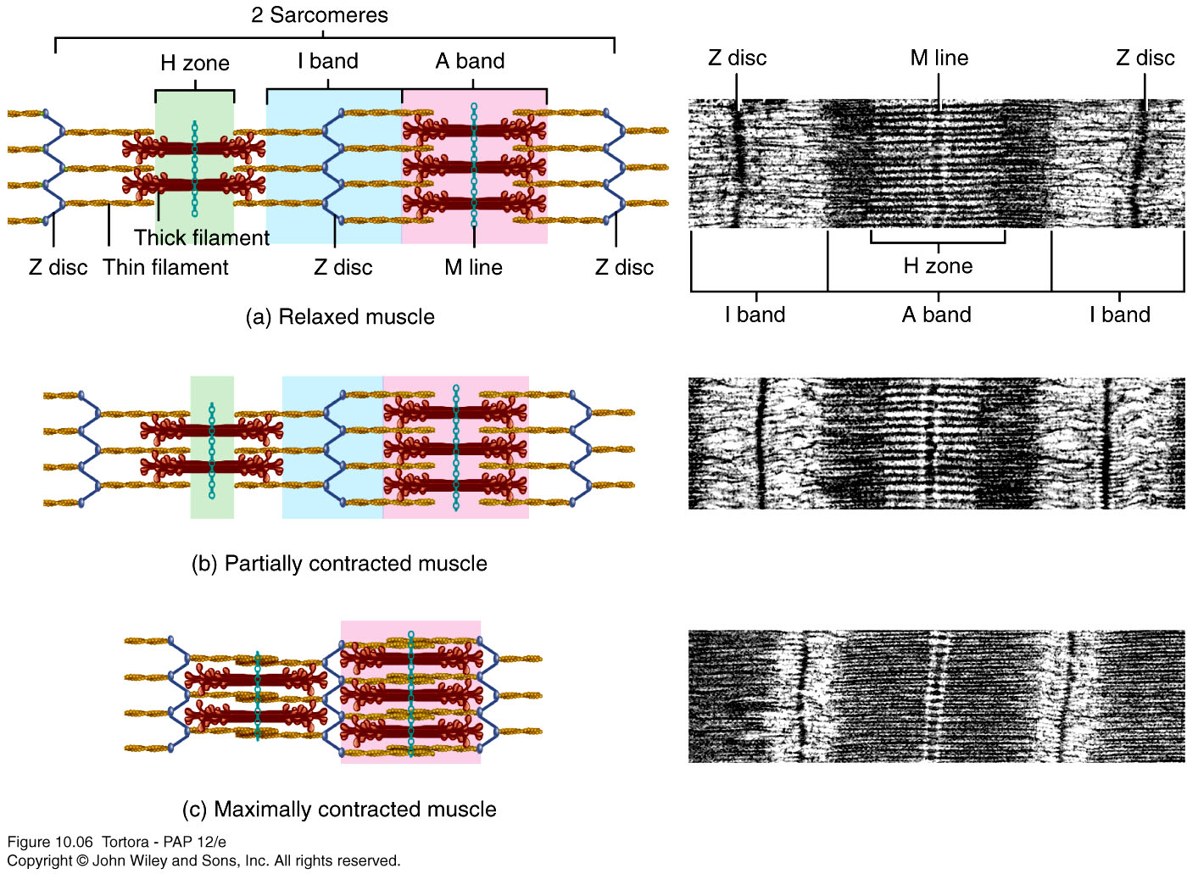
Sarcomere
  Sarcomeres are the repeating functional units of a myofibril. They differ in size, density, and distribution of thick and thin filaments that can give the muscle fibre a banded or striated appearance. About 10,000 sarcomeres per myofibril, end to end, each ~2 µm long.
  A bands: a dark band; full length of thick (myosin) filament
  M line - protein to which myosins attach
  H zone - thick but NO thin filaments
  I bands: a light band; from Z disks to ends of thick filaments
  Z disk: filamentous network of protein. Serves as attachment for actin myofilaments
  Titin filaments: elastic chains of amino acids; keep thick and thin filaments in proper alignment

Slide 12
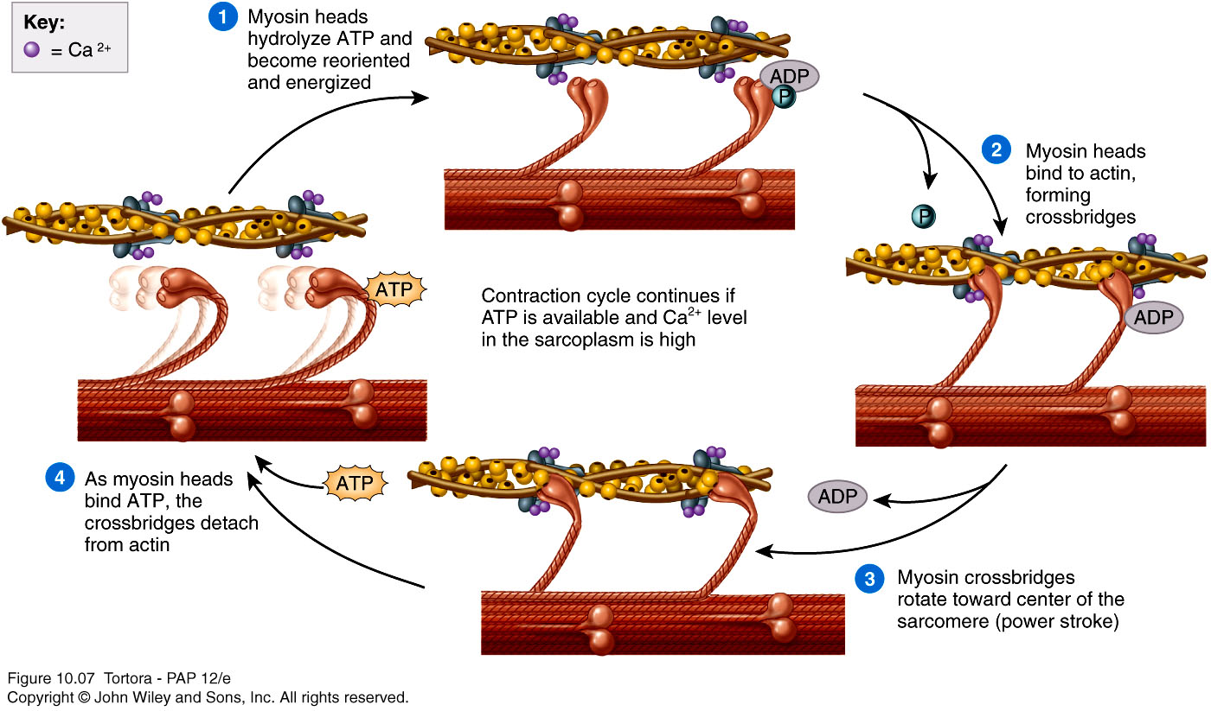
Contraction Cycle
Note the ADP is released after the power stroke
Notes:
Before skeletal muscle can undergo contraction, an electrical signal must be created in the form of an action potential by the brain and then sent to the motor neuron of the somatic nervous system that innervates that particular muscle. It travels along the axon of the motor neuron and eventually reaches the motor end plate (neuromuscular junction), which is the synapse between the axon terminal of the motor neuron and the muscle cell's membrane. The neurotrasmitter acetylcholine depolarizes the membrane and the action potential travels through the transverse tubules (t-tubules) and into the sarcoplasmic reticulum. TThe sarcoplasmic reticulum then releases calcium ions into the cytosol of the cell, which go on to bind to the troponin found on the thin filament. Once calcium binds to troponin, it shifts the tropomyosin and exposes the myosin binding sites. At the same time, the myosin head of the thick filament hydrolyzes ATP into ADP and Pi, which remain attached to the myosin head. The myosin head then orients itself at a ninety degree angle with respect to the thick filament and binds onto the exposed myosin binding site on the thin filament. As soon as the ADP and P are released by the myosin head, the myosin head once more shifts itself and this creates the power stroke that moves the thin filament. This causes the muscle to contract. In order for the myosin to detach itself from the thin filament, ATP must bind to the myosin head. Once ATP binds, calcium detaches from the troponin and the calcium ions are then pumped right back into the sarcoplasmic reticulum. This process can now be repeated.

Slide 13
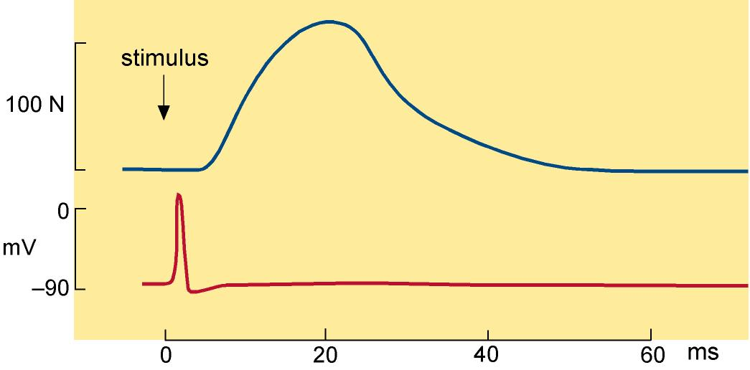
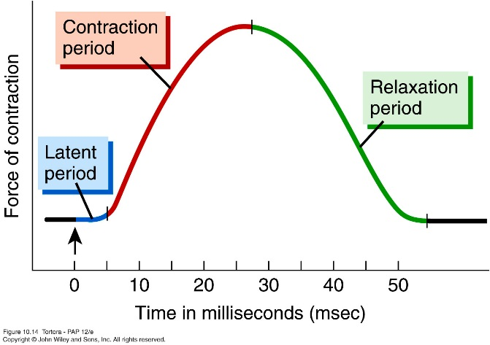
Contractile Response
Muscle Contraction
Action Potential
The contractile response is initiated after the muscle action potential and lasts much longer than the action potential.
Notes:
Mechanics of Muscle Contraction
When muscle is stimulated adequately, it generates an action potential, and
the associated change in membrane potential is translated into Ca++ release
from the sarcoplasmic reticulum. As described by the sliding filament
model, this increased cytosolic [Ca++] results in muscle shortening and force
generation. The magnitudes and rates of these two and other indices of
muscle function are related in complex ways to the load against which the
muscle must work.When a muscle, such as the biceps, is in typical use, it
develops tension with a change in elbow angle while a weight is being lifted.
Although the weight being lifted does not change, the load against which
the muscle works changes as the elbow angle changes. Three experimental
set-ups are frequently used to study this apparently simple physiologic phenomenon:
isometric, isotonic, or isokinetic contractions.

Slide 14
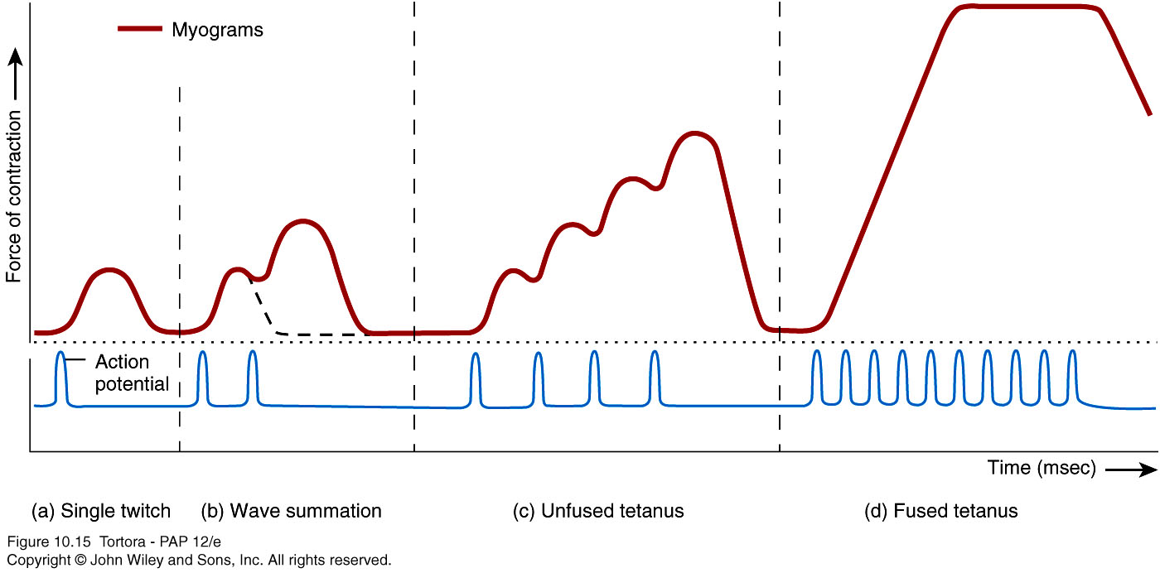
Stimulation Frequency
The contractile response is initiated after the muscle action potential. Different frequencies of stimulation affects contractile force.
Notes:
Twitch-
A single brief contraction
Not a normal muscle function
Tetanus
One contraction immediately followed by another
Muscle never completely returns to a relaxed state
Effects are compounded

Slide 15
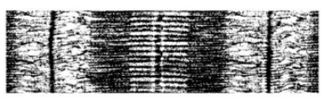
Muscle Tone
As sarcomere length decreases below 2 μm, the thin filaments collide in the middle of the sarcomere, and the actin-myosin interaction is disturbed and hence contractile force decreases.
As muscle length is decreased toward an optimum length (L₀), the amount of overlap increases, and contractile force progressively increases
At a very long sarcomere length (3.65 μm), actin filaments no longer overlap with myosin filaments, so there is no contraction.
Notes:
Thus the initial tone/tension on the muscle affect the activity of the muscle.

Slide 16
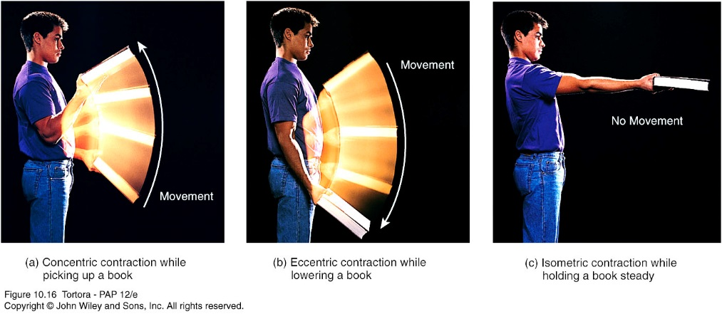
Length-Tension Relationship
When muscles contract, they generate force (often measured as tension or stress) and changes in length i.e. isotonic contractions.
Concentric contraction: is a type of muscle activation that increases the tension on a muscle as it shortens. i.e. a biceps curl with a dumbbell.
Eccentric contraction: during eccentric muscle contractions, the muscle fibers are stretched out. The muscle returns to the starting position of the
Isometric Contraction: isometric contractions do not cause any joint movement. There is no lengthening or contraction of muscles.
For this reason, isometric exercises, as the tension applied to the muscle remains consistent, are used in rehab programs.
Isotonic Isotonic Isometric
Concentric Eccentric
Notes:
the muscle lengthens due to the resistance being greater than the force the muscle is producing.

Slide 17
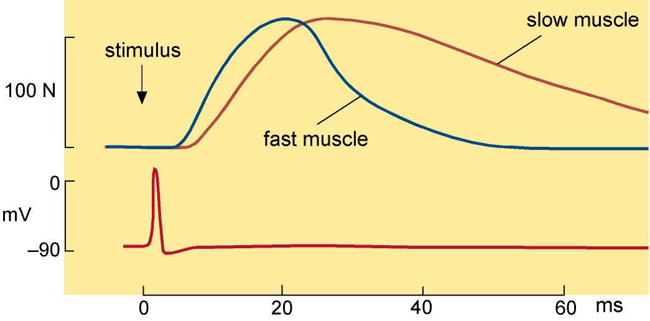
Fast & Slow Muscles
Type 1 Slow Oxidative (darkest)
Type 2A Fast Oxidative (Intermediate)
Type 2B Fast Glycolytic (lightest)
The histochemical assay for Succinate Dehydrogenase (SDH) is used to distinguish between fibres.
Muscle cells which contain more mitochondria will have a higher oxidative capacity. The SDH enzyme is located in the inner membrane of the mitochondrion, bound to the cristae. SDH is responsible for oxidizing succinate to fumarate in the citric acid cycle. The more SDH (and therefore mitochondria) a fibre contains, the greater the intensity of the stain.
Oxidative fibres have a dense, purple speckled appearance, while non-oxidative fibres have only scattered purple speckles. Therefore, this histochemical assay reflects the relative oxidative potential of muscle fibers.
Notes:
Most muscles contain a mix of fast and slow types.
Slow are more postural muscle they contact more slowly but also relax more slowly so good at keeping tone. Operate around 15mm s-1.
Fast fibres operate around 45 mm s-1 simlar to type 1. Type 2B are more anaerobic, fast fibres but they fatigue easily.
Text source: http://muscle.ucsd.edu/musintro/histochem.shtml

Slide 18
Muscle Types
Feature | Slow-Twitch | Fast-Twitch
Myoglobin | High | Low
Contraction Speed | Slow | Fast
Fatigue Resistance | High | Low
Endurance | Long-duration activity | Short bursts of power
Mitochondria | Numerous and large | Fewer and smaller
Capillary Density | High | Low
Energy Source | Aerobic (oxygen, fats) | Anaerobic (glycogen, glucose)
Primary Function | Posture, endurance | Quick, powerful
Example Activities | Distance running, marathons, cycling. | Weightlifting, jumping, sprinting.

Slide 19
Force
When a muscle is activated, it shortens and, in doing so, it exerts a force on the tendons to which it is attached.
The amount of force exerted depends on:
The number of active motor units
The cross-sectional area of the muscle
The frequency of stimulation
The initial resting length of the muscle
The rate at which the muscle shortens

Slide 20

Power
Newtons
Joules
Watts
Force = mass × acceleration
Work = force × distance moved by load
Power = work ÷ time
= (force × distance)
time
= force × velocity
Force= 1 Kg x 1m s⁻¹ = 1 Newton (1 N)
Work = (1 Kg x 1m s⁻¹ ) x 1 m
= 1 Newton Metre (1 N.m) or Joule (J)
2
Power = (1 Kg x 1m s⁻¹ x 1 m) / time
= Joule / second ( J s⁻¹ ) or Watts (W)
1kg
1kg

Slide 21
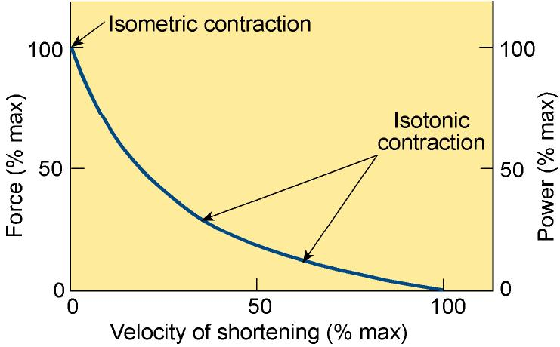
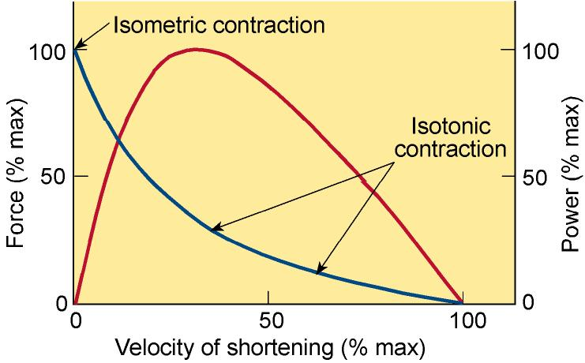
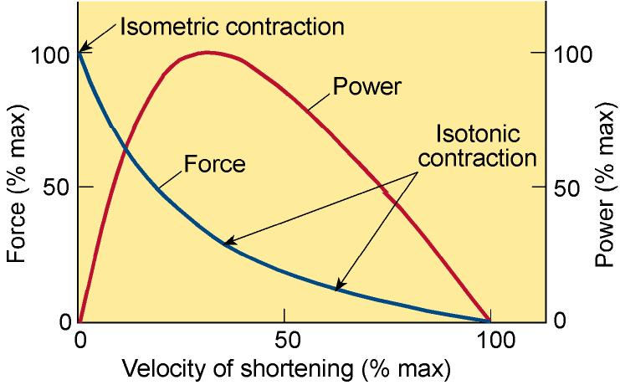
Force-velocity curve
No shortening
1/3rd
No load
Power = Force x velocity of contraction

Slide 22
Summary 1
There are three main types of muscle: skeletal, cardiac and smooth.
Skeletal muscle is made up of long cylindrical, multi-nucleated cells called muscle fibres. Individual muscle fibres contain myofibrils which are made up of repeating units called sarcomeres.
The sarcomeres are the fundamental contractile unit.
The contraction of skeletal muscle is neurogenic in origin.
Muscles contract because the thin and thick filaments move relative to each other.
The interaction between the thin and thick filaments is regulated by Ca²⁺.

Slide 23
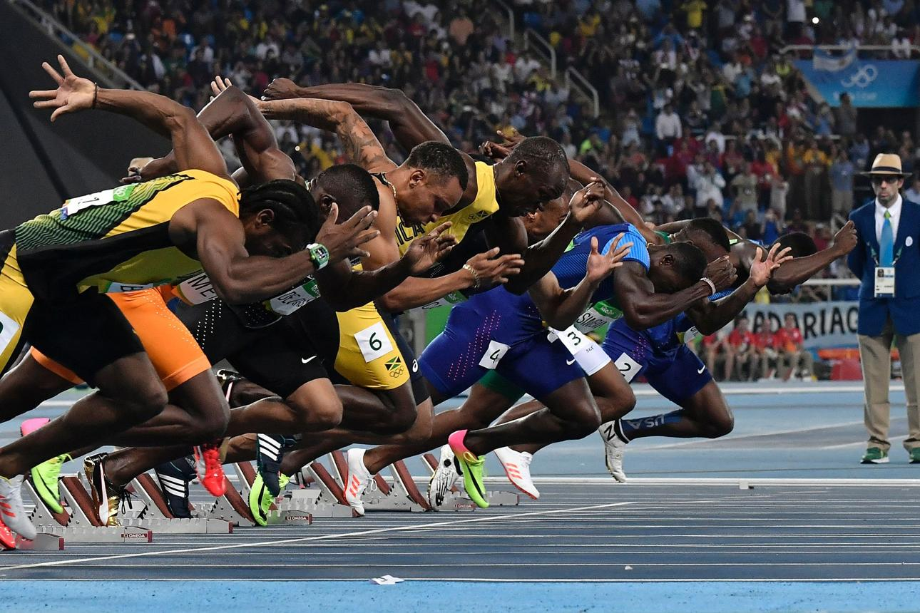
Summary 2
The force developed by a muscle depends on:
The number of active motor units
The cross-sectional area of the muscle
The frequency of stimulation
The initial resting length of the muscle
The rate at which the muscle shortens

Slide 24
Useful links
https://www.youtube.com/watch?v=sIH8uOg8ddw
https://www.youtube.com/watch?v=DfKKf89-dFI
https://www.youtube.com/watch?v=UhSSqToeMsI
Recommended Reading
Pocock, Richards and Richards “Human Physiology”
5th edn p120-131
4th edn p117-127
3rd edn p83-92
2nd edn p97-105

Slide 25
Assessment
Single Best Answer (SBA) style question
Lt pre practical quiz (formative)
Lt post-practical quiz (summative)
Test One (summative)
“Where would you find titin within a muscle cell?”
On the plasma membrane outer surface
On the inside of the sarcolemma
One the nuclear membrane surrounding the nucleus
Within the transverse tubules
On the sarcoplasmic reticulum membrane

Slide 26
Assessment
Essay style question:
“Compare and contast the differences in muscle type between an weight lifter and a mountaineer.” 8 marks.
Calculation style question:
“Suppose a sprinter exerts an average forward force of 600 N while running at 10m per second. What power do they exert in KW.”

